Slide 1
Computer Science
Tony Gaddis 5th Ed Starting Out with C++
Chapter 5
Looping
Mohammad Al-Husseini

Slide 2
Increment and Decrement
Increment means to increase a value by one
num = num + 1; num += 1;
There is a simple short hand for this, known as the increment operator
num++;
Decrementation is the same, except you reduce the value by 1
num = num – 1; num -= 1;
num--;
Note: These change the value of the variable

Slide 3
Prefix and Postfix Modes
num++ is using the increment operator in postfix mode
This means that the incrementation is the last operation in the statement
num = 4; cout << num++;
This displays 4, but num becomes 5
++num is prefix mode
So the incrementation happens first
num = 4; cout << ++num;
This displays 5 and num becomes 5

Slide 4
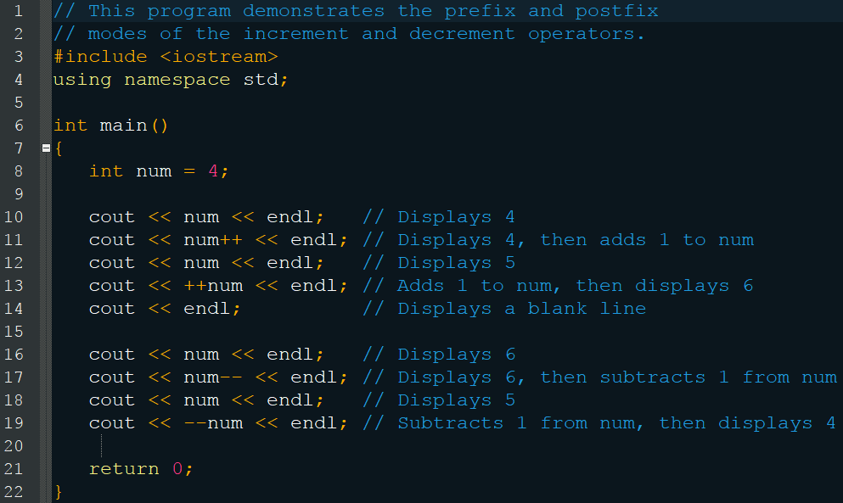
Prefix and Postfix Modes

Slide 5
++ and -- In
You can use these in any expression with a single variable
Mathematical Expressions
a = 2, b = 5, c = a * b++;
Beware: c = ++(a * b);
Relational Expressions
x = 10; if (x++ > 10) cout << “x is greater than 10.”;

Slide 6
Checkpoint
What will the following display?
x = 2; y = x++; cout << x << y;
x = 2; y = ++x; cout << x << y;
x = 2; y = 4; cout << x++ << --y;
x = 2; y = 2 * x++; cout << x << y;

Slide 7
Checkpoint
What will the following display?
x = 99; if (x++ < 100) cout << “It is true!”; else cout << “It is false!”;
x = 0; if (++x) cout << “It is true!”; else cout << “It is false!”;

Slide 8
Loops
Essentially an if statement that continues repeating until false
Three varieties that vary in the way they continue the repetition
while
do-while
for

Slide 9
The While Loop
Continues looping while the expression is true
while (expression) statement;
while (expression) { statement; … statement; }
Will not execute (or will stop executing) when the expression is/becomes false

Slide 10
The While Loop
expression
True
statement(s)
False

Slide 11
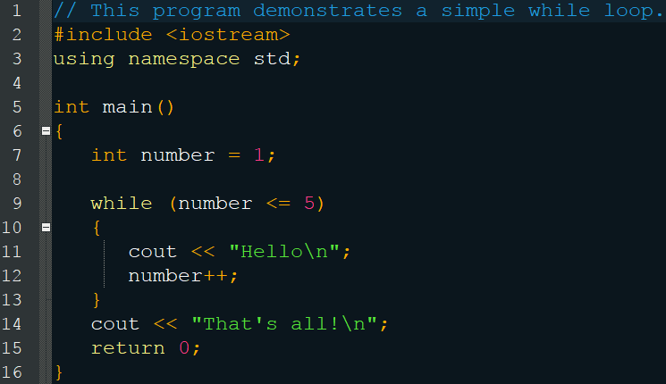
The While Loop
“Hello\n” five times “That’s all!\n”

Slide 12
The While Loop
Is a pretest loop, meaning it checks if the expression is true before executing
int number = 6; while (number <= 5) { cout << “Hello\n”; number++; }
Displays nothing

Slide 13
Infinite Loops
If the expression is never becomes false, you will be stuck in the loop forever
int number = 1; while (number <= 5) cout << “Hello\n”;
If you place a semicolon after the loop, it will also become infinite
int number = 1; while (number <= 5); { cout << “Hello\n”; number++; }

Slide 14
Loop Braces
Like if statements, you must include braces if you want statements past the first to be included
int number = 1; while(number <= 5) cout << “Hello\n”; number++;
This is an infinite loop, because the incrementation happens after the loop, which never ends
Remember good programming style: indentations and braces

Slide 15
Validating Input
while loops are excellent for input validation
The loop can repeat until the correct input is entered
cout << “Enter a number in the range 1 – 100: ”; cin >> number; while (number < 1 || number > 100) { cout << “ERROR: Enter a value in the range 1-100: “; cin >> number; }

Slide 16
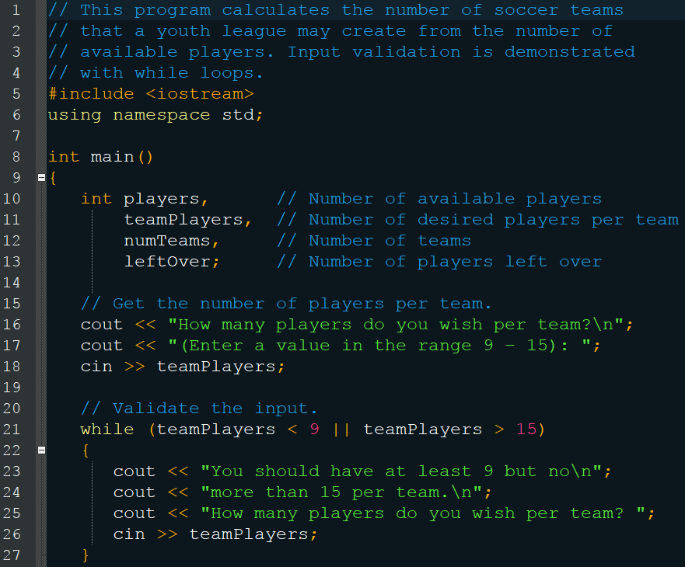
Validating Input

Slide 17
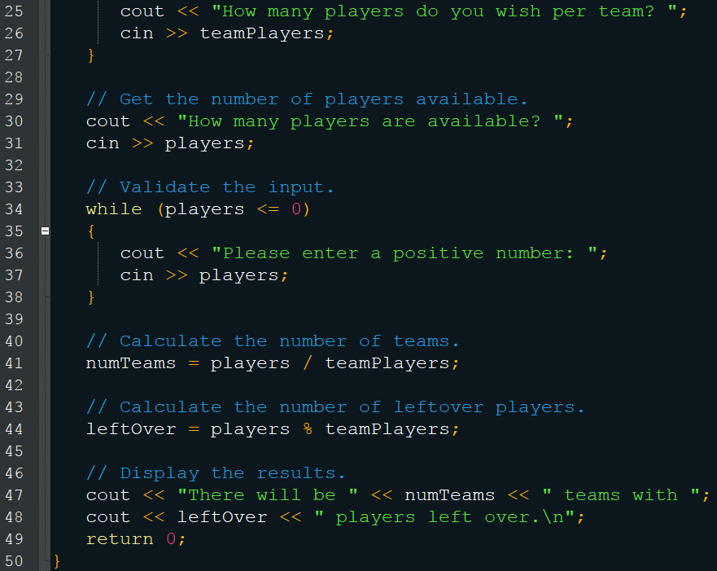
Validating Input

Slide 18
Counters
Just a variable that increments or decrements each time a loop iterates
Counts the number of times a loop iterates
Must be initialized
int num = 0; // counter while (num++ < 10) cout << num << “ “ << num * num << endl;

Slide 19
Checkpoint
Write an input validation loop that asks the user to enter a number in the range of 10 through 25.
Write an input validation loop that asks the user to enter ‘Y’, ‘y’, ‘N’, or ‘n’.
Write an input validation loop that asks the user to enter “Yes” or “No”.

Slide 20
The do-while Loop
Like the while loop, but it is posttest
It does the statements first, then tests the expression to loop
do { statement; … statement; } while (expression);
Don’t forget the semicolon after the while (but only for do-while)

Slide 21
The do-while Loop
statement(s)
expression
True
False

Slide 22
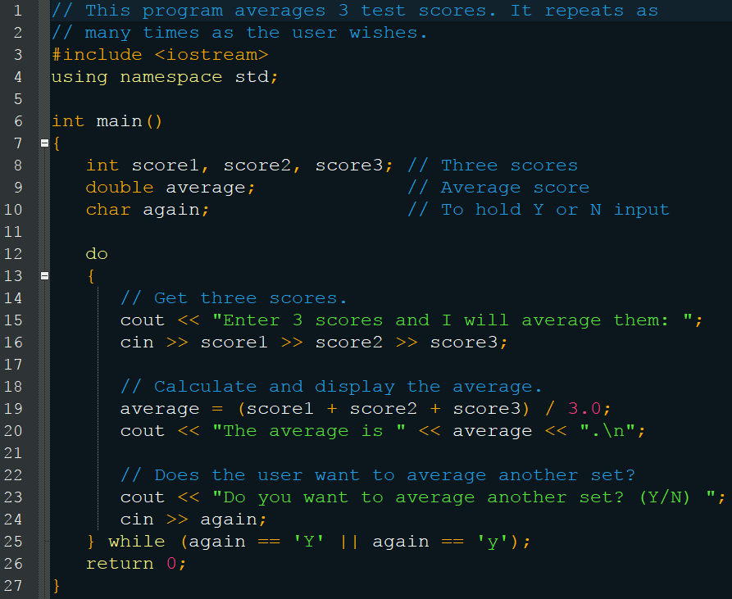
The do-while Loop

Slide 23
The do-while Loop
Essentially a while loop, but you want it to run the code one time first (post test)
Don’t forget the semicolon after the while portion (but not for a regular while loop)
Particularly useful with menu driven programs

Slide 24
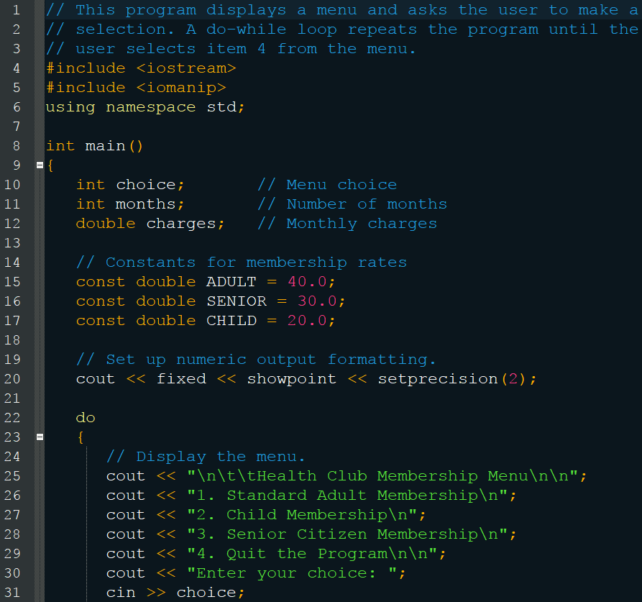
do-while Loop Menu

Slide 25
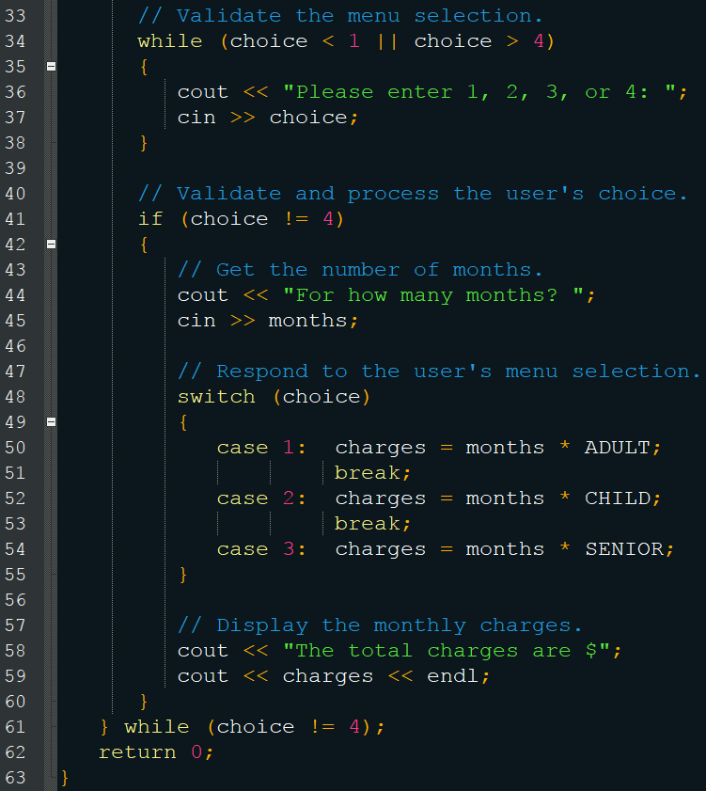
do-while Loop Menu

Slide 26
Checkpoint
What will the following display?
int count = 10; do cout << “Hello World” << endl; while (count++ < 1);
int v = 0; do cout << v++; while (v < 5);

Slide 27
Checkpoint
int count = 0, funny = 1, serious = 0, limit = 4; do { funny++; serious += 2; } while (count++ < limit); cout << funny << “ “ << serious << “ “ << count;
Write a program segment with a do-while loop that asks the user to enter a number. The loop should keep a running total of the numbers entered, and stop when the total is greater than 300.

Slide 28
The for Loop
Two categories of loops
conditional loop = executes as long as a particular condition exists, such as while and do-while
count-controlled loop = iterates an exact number of times (such as 12 months in a year), this is the “for”
There are three steps to count-controlled loops
Initialize a counter variable to a starting value
Test the counter variable compared to the maximum value and terminate the loop if reached
Update the counter variable each iteration
Count-controlled loops are so common that C++ made the for loop

Slide 29
The for Loop
for (initialization; test; update) { statement; … statement; }
for (int number = 1; number <= 10; number++) cout << number << endl;
Note the semicolons

Slide 30
The for Loop
Assign 1 to number
number <= 10
True
cout << number
Increment number
False

Slide 31
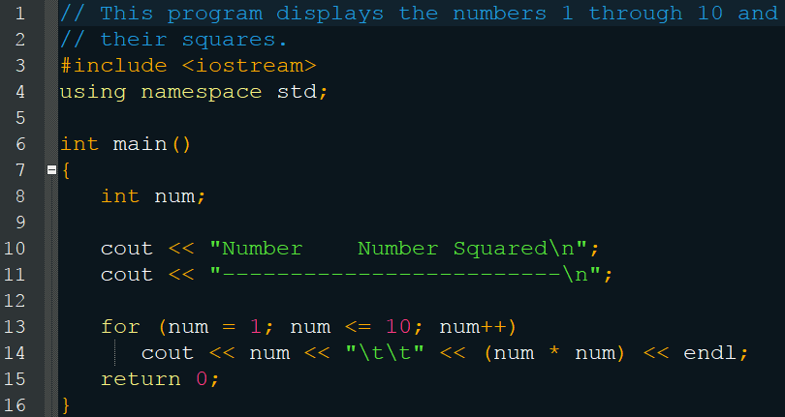
The for Loop

Slide 32
The for Loop
Pretest loop
int count = 0; for (count = 11; count <= 10; count++) cout << “Hello” << endl;
Will not activate
Also note that you can use an existing variable instead of defining it within the for header
Beware adjusting count inside the body
int count; for (count = 0; count <= 10; count++) { cout << “Hello” << endl; count++; }

Slide 33
The for Loop
You can use various forms of update expressions, provided they eventually cause the loop to terminate
for (num = 2; num <= 100; num += 2) cout << num << endl;
for (num = 10; num >= 0; num--) cout << num << endl;

Slide 34
The for Loop
If you define the counter variable in the for header, it only have scope within the loop
for (int count = 1; count <= 10; count++) cout << count << endl; cout << “count is now “ << count; // Error
int count; for(count = 1; count <= 10; count++) cout << count << endl; cout << “count is now “ << count; // Valid

Slide 35
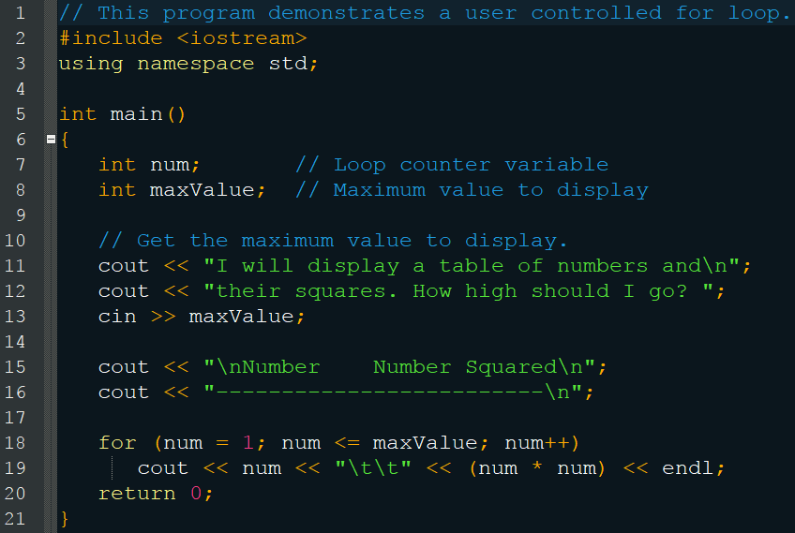
User Controlled for Loop

Slide 36
The for Loop
You can have more than one statement in the initialization and update expressions
int x, y; for (x = 1, y = 1; x <= 5; x++, y++) { cout << x << “ plus “ << y << “ equals “ << x + y << endl; }
Do not try this with the test expression, however
You must use && or ||

Slide 37
The for Loop
You can omit any or all of a for loop’s expressions
int num = 1; for ( ; num <= maxValue; num++) cout << num << endl;
int num = 1; for ( ; num <= maxValue; ) { cout << num << endl; num ++; }
for ( ; ; ) cout << “Hello World!” << endl; // Infinite Loop

Slide 38
Keeping a Running Total
Sometimes you need to calculate the total of a series of numbers that are provided as input
This can be done with a variable, known as an accumulator

Slide 39
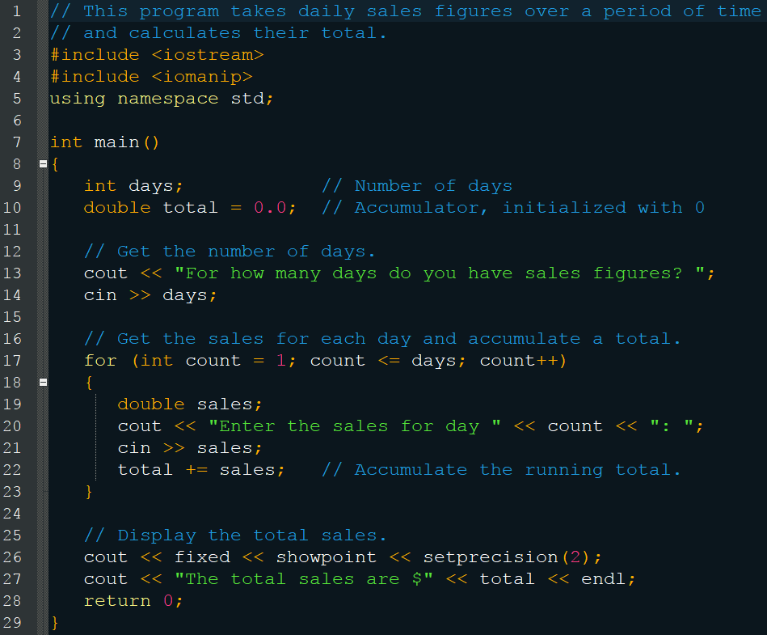
Keeping a Running Total

Slide 40
Which Loop?
While
Pretest
Good for validation
When you don’t know the number of loops
Do-While
Posttest
Good for menus
When you want the code to run at least once
For
Pretest
You know how many times you want to loop

Slide 41
Checkpoint
Name the three expressions in the for header.
You want to write a for loop that displays “I love to program” 50 times. Your counter variable is declared as count.
What initialization expression will you use?
What test expression will you use?
What update expression will you use?
Write the loop.

Slide 42
Checkpoint
What will the following display?
for (int count = 0; count < 6; count++) count << (count + count);
for (int value = -5; value < 5; value++) cout << value;
int x; for (x = 5; x <= 14; x += 3) cout << x << endl; cout << x;
Write a for loop that displays your name 10 times.

Slide 43

Checkpoint
Write a for loop that displays all the odd numbers, 1 through 49.
Write a for loop that displays every fifth number, 0 through 100.
Write a for loop that repeats seven times, asking the user to enter a number. The loop should also calculate the sumo f the numbers entered.
Write a for loop that calculates the following $\frac{1}{30}$+$\frac{2}{29}$+$\frac{3}{28}$+$\frac{4}{27}$+…+$\frac{30}{1}$

Slide 44
Sentinels
A special value that marks the end of a list
Cannot be a value that could appear in the list
You choose the value
Useful for when you don’t know how long the list is

Slide 45
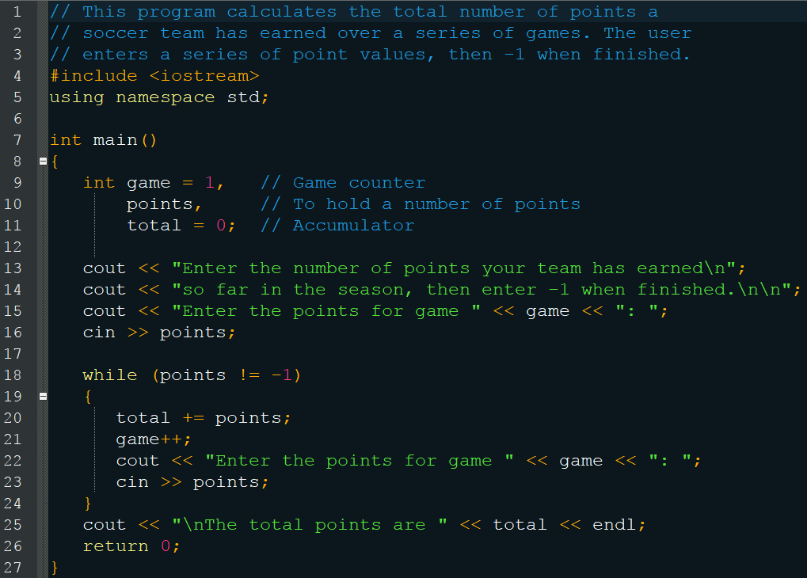
Sentinels

Slide 46
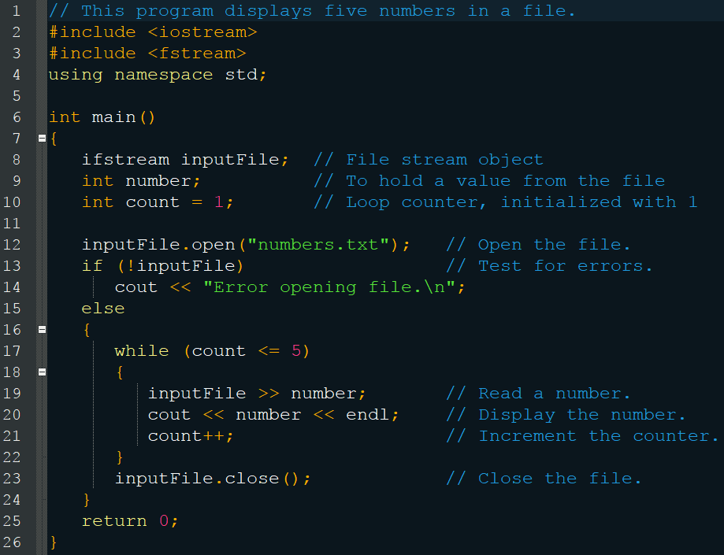
Loops to Read from Files

Slide 47
Loops to Read from Files
The problem with this program is that it assumes the file has exactly 5 numbers
Recall that opening a file sets the object to true or false, if it opened successfully
A similar behavior exists when reading data from a file
inputFile >> number;
Returns true if there was a number to read false if there wasn’t
We can utilize this to read any number of files

Slide 48
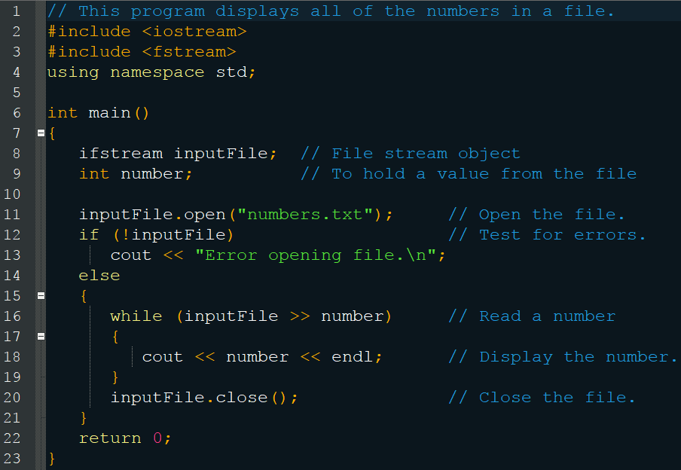
Loops to Read from Files

Slide 49
Checkpoint
Which variable below is the accumulator int a, x, y = 0; for (x = 0; x < 10; x++) { cout << “Enter a number: “; cin >> a; y += a; }
Why do you need to be careful when choosing a sentinel?

Slide 50
Checkpoint
How would you modify the soccer program to accept any negative number as a sentinel?
Assume a file named values.txt exists and contains a series of numbers, one per line in the file. Also assume that the program successfully executes the following statements to open the file: ifstream inputFile; inputFile.open(“values.txt”); Write a loop that reads and displays each number.

Slide 51
Nested Loops
When you need to perform a very repetitious task, such as a clock
60 seconds, 60 minutes, 24 hours

Slide 52
Nested Loops
cout << fixed << right; cout.fill(‘0’); for (int hours = 0; hours < 24; hours++) { for (int minutes = 0; minutes < 60; minutes++) { for(int seconds = 0; seconds < 60; seconds++) { cout << setw(2) << hours << “:” cout << setw(2) << minutes << “:”; cout << setw(2) << seconds << “:”; } } }

Slide 53
Nested Loops
Displays the output as follows 00:00:00 00:00:01 … 23:59:59
The inner loop goes through all its iterations for each iteration of the outer loop
The hours loop iterates 24 times The minutes loop iterates 1,440 times The seconds loop iterates 86,400 times
Multiply to determine the number: 60 * 60 * 24

Slide 54
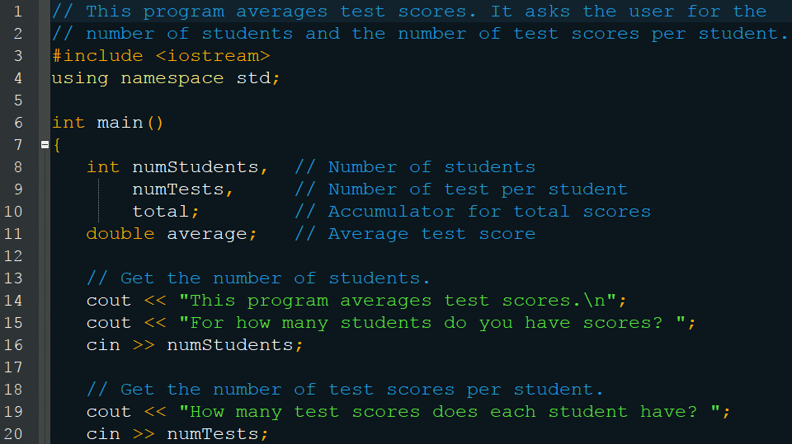
Nested Loops

Slide 55
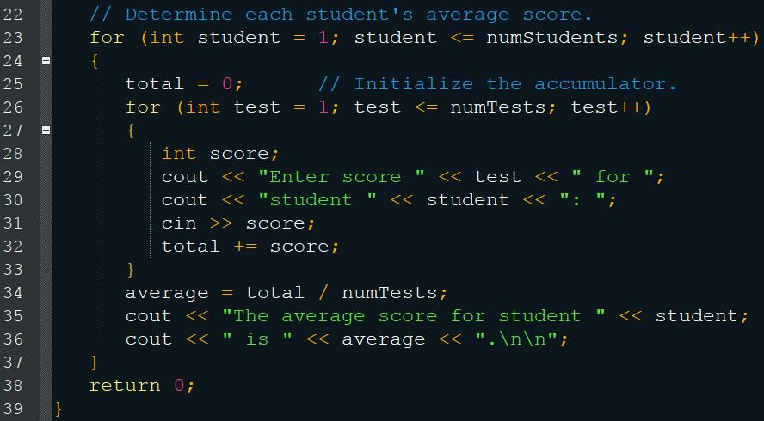
Nested Loops

Slide 56
Breaking Out of a Loop
You can use the break keyword to terminate a loop early
Be cautious however, as it makes it difficult to debug
int count = 0; while (count++ < 10) { cout << count << endl; if (count == 5) break; }

Slide 57
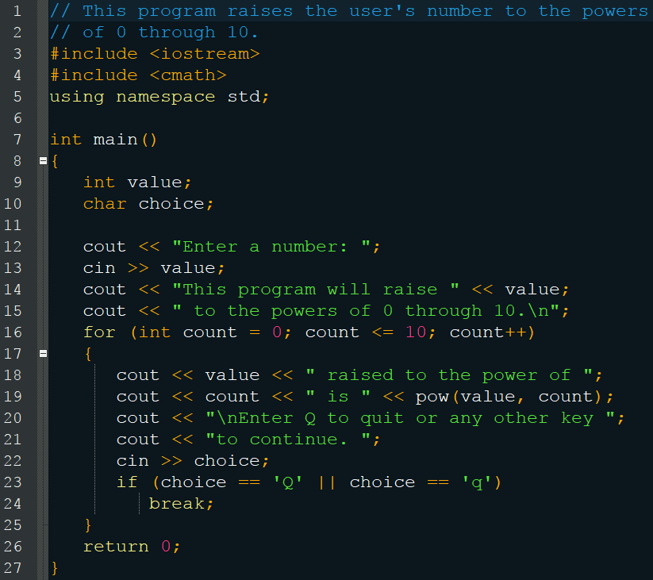
Breaking Out of a Loop

Slide 58
Breaking Out of a Loop
If using break in a nested loop, it only terminates that loop, not the outer one
for (int row = 0; row < 5; row++) { for (int star = 0; star < 20; star++) { cout << ‘*’; if (star == 10) break; } }
Results in 5 rows of 10 stars

Slide 59
The continue Statement
Stops executing the current iteration and continues to the next
Be cautious again, debugging and what not
int testVal = 0; while (testVal++ < 10) { if (testVal == 4) continue; cout << testVal << “ “; }
1 2 3 5 6 7 8 9 10

Slide 60
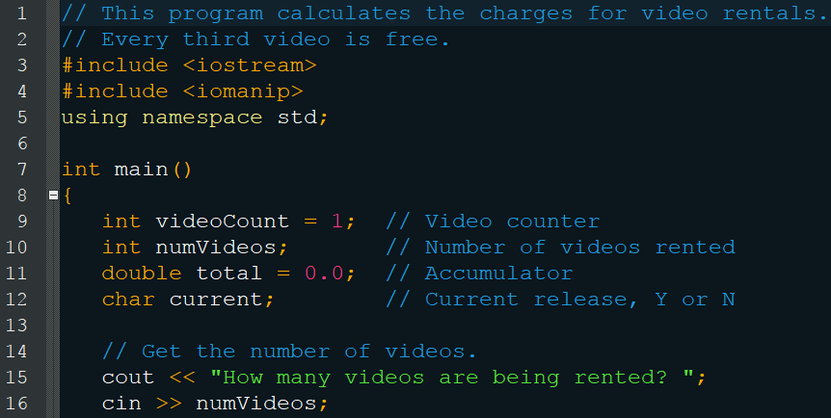
The continue Statement

Slide 61
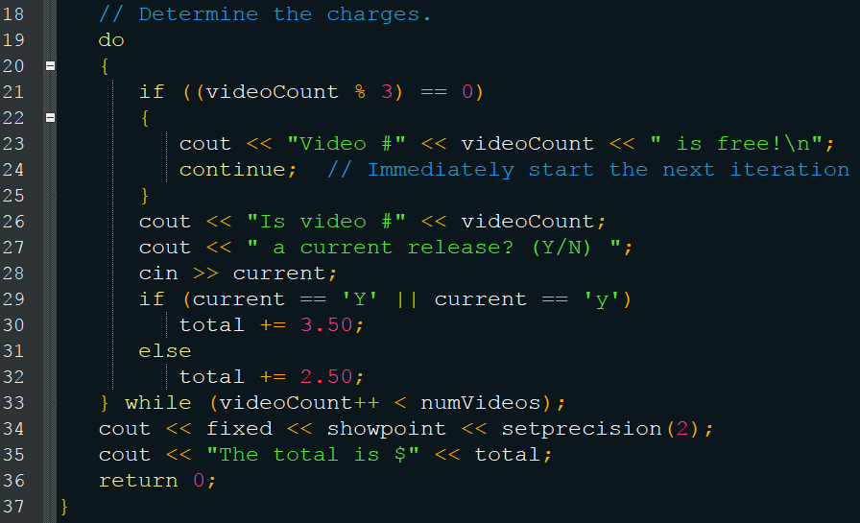
The continue Statement

Slide 62
Checkpoint
How many times does a nested loop iterate?
Why should you be cautious with continue and break statements?

